Slide 1
Chapter – 7
Space and Time Tradeoffs
By Dr. Shashikumar G. Totad

Slide 2
Chapter – 7
Space and Time Tradeoffs
Contents
Input Enhancement in String Matching,
Hashing

Slide 3
Space and Time Tradeoffs
Consider the problem of computing values of a function at many points in its domain - If it is
time that is at a premium, we can pre compute the function’s values and store them in a table.
Input Enhancement Approach - Idea is to preprocess the problem’s input, in whole or in part, and store the additional information obtained to accelerate solving the problem afterward.
Notes:
On average, however, we should expect just a few comparisons before a pattern’s shift, and for
random natural-language texts, the average-case efficiency indeed turns out to be in O(n+ m).

Slide 4
1. Input Enhancement in String Matching
Problem of string matching requires finding an occurrence of a given string of m characters
called the pattern in a longer string of n characters called the text.
The brute-force algorithm simply matches corresponding pairs of characters in the pattern
and the text left to right and, if a mismatch occurs, shifts the pattern one position to the right
for the next trial.
Since the maximum number of such trials is (n − m+1) and, in the worst case, m comparisons
need to be made on each of them, the worst-case efficiency of the brute-force algorithm is O(nm).
Average-case efficiency is O(n+ m).
Input-Enhancement Idea:
preprocess the pattern to get some information about it,
store this information in a table,
use this information during an actual search for the pattern in a given text.

Slide 5
1. Input Enhancement in String Matching
Horspool’s Algorithm:
Simplified version of the Boyer-Moore algorithm suggested by R. Horspool [Hor80].
Horspool’s algorithm is not less efficient than the Boyer-Moore algorithm on random strings.
Example: Searching for the pattern BARBER in some text:
Starting with the last R of the pattern and moving right to left, the corresponding pairs of characters in the pattern and the text are compared.
If all the pattern’s characters match successfully, a matching substring is found - Then the search can be either stopped altogether or continued if another occurrence of the same
pattern is desired.
If a mismatch occurs, we need to shift the pattern to the right, making as large a shift as possible without risking the possibility of missing a matching substring in the text.
s₀ ... c ... s_{n−1}
B A R B E R
Notes:
two best known algorithms of this type:the Knuth-Morris-Prattalgorithm[Knu77]and the Boyer-Moore algorithm [Boy77].
underlying idea of the Boyer-Moore algorithm is simple, its actual implementation in a working method is less so. Therefore, we start our discussion with a simplified version of the Boyer-Moore algorithm suggested by R. Horspool [Hor80]. In addition to being simpler, Horspool’s algorithm is not necessarily less efficient than the Boyer-Moore algorithm on random strings.

Slide 6
1. Input Enhancement in String Matching
Horspool’s Algorithm: . . .
Example: Searching for the pattern BARBER in some text:
Following four possibilities can occur:
Case-1: If there are no c’s in the pattern we can safely shift the pattern by its entire length
s₀ ... S ... s_{n−1}
≠
B A R B E R
B A R B E R

Slide 7
1. Input Enhancement in String Matching
Horspool’s Algorithm: . . .
Example: Searching for the pattern BARBER in some text:
Following four possibilities can occur: . . .
Case-2: If there are occurrences of character in the pattern but it is not the last one there,
the shift should align the rightmost occurrence of c in the pattern with the c in the text:
s₀ ... B ... s_{n−1}
≠
B A R B E R
B A R B E R

Slide 8
1. Input Enhancement in String Matching
Horspool’s Algorithm: . . .
Example: Searching for the pattern BARBER in some text:
Following four possibilities can occur: . . .
Case-3: If c happens to be the last character in the pattern but there are no c’s among its
other m−1 characters —the situation is similar to that of Case 1 and the pattern
should be shifted by the entire pattern’s length m:
s₀ ... M E R ... s_{n−1}
_{≠ = =}
L E A D E R
L E A D E R

Slide 9
1. Input Enhancement in String Matching
Horspool’s Algorithm: . . .
Example: Searching for the pattern BARBER in some text:
Following four possibilities can occur: . . .
Case-4: if c happens to be the last character in the pattern and there are other c’s among
its first m − 1 characters, the situation is similar to that of Case 2 and the right
most occurrence of c among the first m −1 characters in the pattern should be
aligned with the text’s c:
s₀ ... A R ... s_{n−1}
_{≠ =}
R E O R D E R
R E O R D E R

Slide 10
1. Input Enhancement in String Matching
Horspool’s Algorithm: . . .
Shift sizes can be precompute and stored in a table.
The table will be indexed by all possible characters that can be encountered in a text,
including, the space, punctuation symbols, and other special characters.
The table’s entries will indicate the shift sizes computed by the formula:

Slide 11
1. Input Enhancement in String Matching
Horspool’s Algorithm: . . .
ALGORITHM ShiftTable(P[0..m−1])
//Fills the shift table used by Horspool’s and Boyer-Moore algorithms
//Input: Pattern P[0..m − 1]and an alphabet of possible characters
//Output: Table[0..size − 1] indexed by the alphabet’s characters and
// filled with shift sizes computed by the formula’
for i ←0 to size−1 do Table[i]←m
for j ←0 to m−2 do Table[P[j]]←m−1−j
return Table

Slide 12
1. Input Enhancement in String Matching
Horspool’s Algorithm: . . .
The Algorithm
Step 1: For a given pattern of length m and the alphabet used in both the pattern and text, construct the shift table as described above.
Step 2: Align the pattern against the beginning of the text.
Step 3: Repeat the following until either a matching substring is found or the pattern reaches beyond the last character of the text. Starting with the last character in the pattern, compare the corresponding characters in the pattern and text until either all m characters are matched (then stop) or a mismatching pair is encountered. In the latter case, retrieve the entry t(c) from the c’s column of the shift table where c is the text’s character currently aligned against the last character of the pattern, and shift the pattern by t(c) characters to the right along the text.

Slide 13
1. Input Enhancement in String Matching
Horspool’s Algorithm: . . .
The Algorithm
ALGORITHM HorspoolMatching(P[0..m−1],T[0..n−1])
//Implements Horspool’s algorithm for string matching
//Input: Pattern P[0..m − 1]and text T[0..n − 1]
//Output: The index of the left end of the first matching substring or −1 if there are no matches.
ShiftTable(P[0..m − 1]) //generate Table of shifts
i ←m−1 //position of the pattern’s right end
while (i ≤n−1) do
k ←0 //number of matched characters
while (k ≤m−1 and P[m−1−k]=T[i −k]) do
k ←k+1
if k =m return i − m+1
else i ←i +Table[T[i]]
return −1

Slide 14
1. Input Enhancement in String Matching
Horspool’s Algorithm: . . .
Example: searching for the pattern BARBER in a text that comprises English letters
and spaces (denoted by underscores). The shift table, as we mentioned, is filled as
follows:

Slide 15
Chapter – 7
Space and Time Tradeoffs
Contents
Input Enhancement in String Matching,
Hashing

Slide 16
2. Hashing
Hashing is a technique used in data structures that efficiently stores and retrieves data in a way that allows for quick access.
Hashing involves mapping data to a specific index in a hash table (an array of items) using a hash function. It enables fast retrieval of information based on its key.
The great thing about hashing is, we can achieve all three operations (search, insert and delete) in O(1) time on average.
Hashing is mainly used to implement a set of distinct items (only keys) and dictionaries (key value pairs).

Slide 17
2. Hashing . . .
Assume that we have to implement a dictionary of n records with keys K₁, K₂, . . . , K_{n}.
Hashing is based on the idea of distributing keys among a one-dimensional array H[0..m − 1] called a hash table.
The distribution is done by computing, for each of the keys, the value of some predefined function h called the hash function.
This function assigns an integer between 0 and m − 1, called the hash address, to a key.
Example: if keys are nonnegative integers, a hash function can be of the form h(K) = K mod m;
Remainder of division by m is always between 0 andm − 1.
If keys are letters of some alphabet, we can first assign a letter its position in the alphabet, denoted here ord(K), and then apply the same kind of a function used for integers.

Slide 18
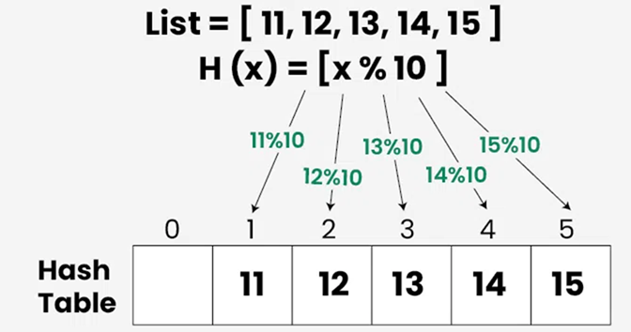
2. Hashing . . .

Slide 19
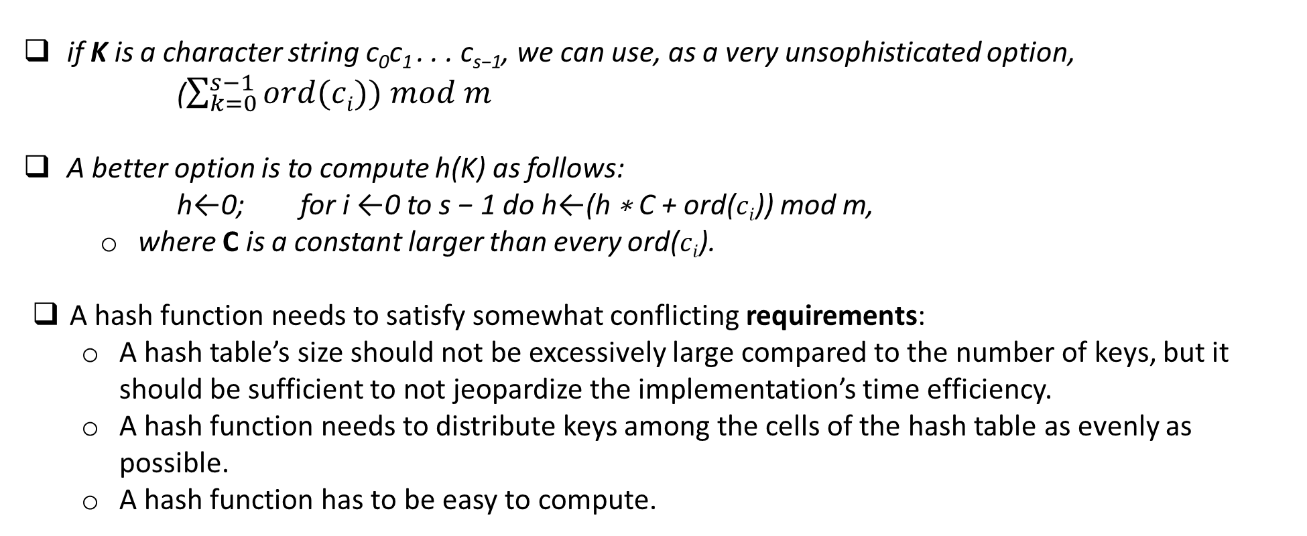
2. Hashing . . .
Notes:
A hash function needs to distribute keys among the cells of the hash table as evenly as possible. (This requirement makes it desirable, for most applications, to have a hash function dependent on all bits of a key, not just some of them.)

Slide 20
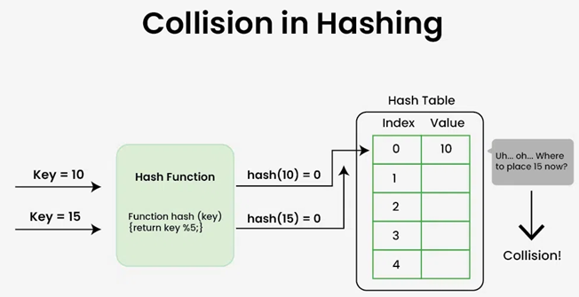
2. Hashing . . . Collision
Collision is a phenomenon of two (or more) keys being hashed into the same cell of the hash table, i.e., When two or more keys have the same hash value.
Every hashing scheme must have a collision resolution mechanism.

Slide 21
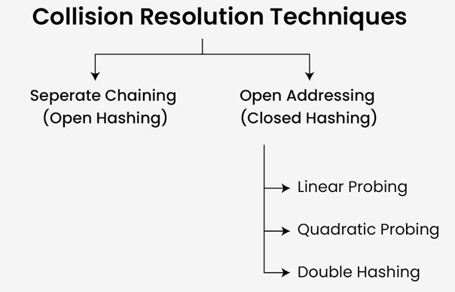
2. Hashing . . . Collision Resolution Techniques
There are two principal versions of hashing:
Open hashing (also called separate chaining)
Closed hashing (also called open addressing).
Collision resolution mechanism is different in the two versions

Slide 22
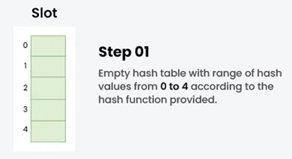
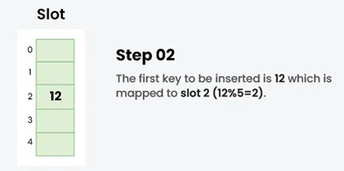
2. Hashing . . . Collision Resolution Techniques
Separate Chaining:
The idea behind Separate Chaining is to make each cell of the hash table point to a linked list of records that have the same hash function value. Chaining is simple but requires additional memory outside the table.
Example: Hash function = key % 5, Elements = 12, 15, 22, 25 and 37.

Slide 23
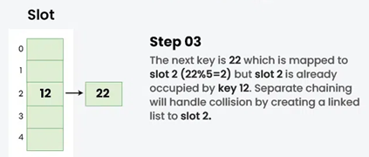
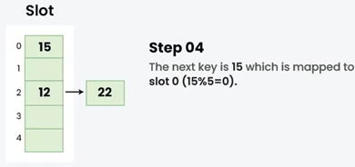
2. Hashing . . . Collision Resolution Techniques
Separate Chaining: . . .
Example: Hash function = key % 5, Elements = 12, 22, 15, 25 and 37.

Slide 24
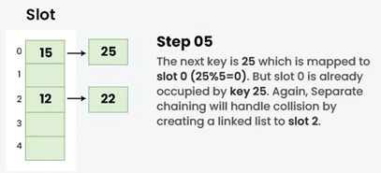
2. Hashing . . . Collision Resolution Techniques
Separate Chaining: . . .
Example: Hash function = key % 5, Elements = 12, 15, 22, 25 and 37.

Slide 25
2. Hashing . . . Collision Resolution Techniques
Separate Chaining: . . .
If the hash function distributes n keys among m cells of the hash table about evenly, each list will be about n/m keys long.
Load factor: The ratio α = n/m load factor of the hash table - plays a crucial role in the efficiency of hashing.
In particular, the average number of pointers (chain links) inspected in successful searches, S, and unsuccessful searches, U, turns out to be:
S ≈ 1+ (α/2) and U = α,
respectively, under the standard assumptions of searching for a randomly selected element and a hash function distributing keys uniformly among the table’s cells.
Load factor to be not far from 1.
Having it too small would imply a lot of empty lists and hence inefficient use of space;
Having it too large would mean longer linked lists and hence longer search times.

Slide 26
2. Hashing . . . Collision Resolution Techniques
Open Addressing:
In closed hashing, all keys are stored in the hash table itself without the use of linked lists.
The table size m must be at least as large as the number of keys n.
Different strategies can be employed for collision resolution:
linear probing, Quadratic Probing, Double hashing
Linear probing:
Checks the cell following the one where the collision occurs.
If that cell is empty, the new key is installed there;
if the next cell is already occupied, the availability of that cell's immediate successor is checked, and so on.
Note that if the end of the hash table is reached, the search is wrapped to the beginning of the table; that is, it is treated as a circular array.

Slide 27
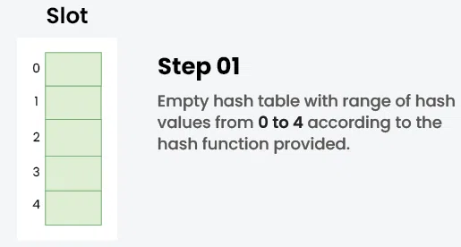
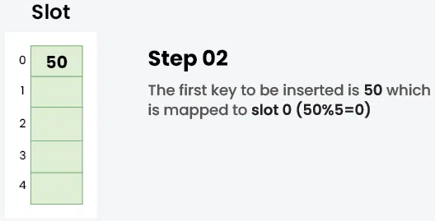
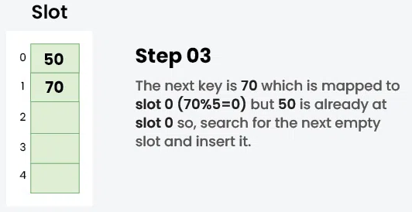
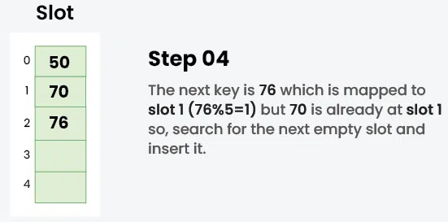
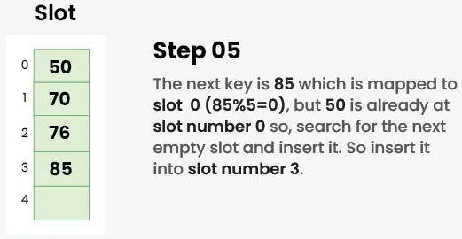
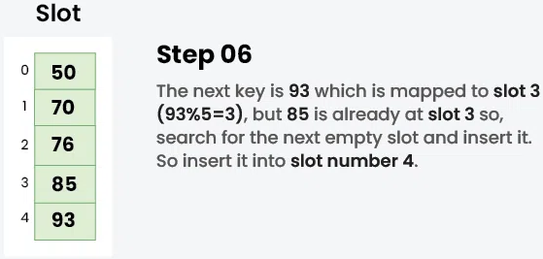
2. Hashing . . . Collision Resolution Techniques
Closed Hashing(Open Addressing): . . .
Linear Probing : . . .Example: hash function- key mod 5 , sequence of keys that are to be inserted are 50, 70, 76, 85, 93.
Notes:
as the hash table gets closer to being full, the performance of linear probing deteriorates because of a phenomenon called clustering. A cluster in linear probing is a sequence of contiguously occupied cells (with a possible wrapping). Clusters are bad news in hashing because they make the dictionary operations less efficient. As clusters become larger, the probability that a new element will be attached to a cluster increases; in addition, large clusters increase the probability that two clusters will coalesce after a new key’s insertion, causing even more clustering.

Slide 28
2. Hashing . . . Collision Resolution Techniques
Closed Hashing(Open Addressing): . . .
Linear Probing : . . .
As the hash table gets closer to being full, the performance of linear probing deteriorates because of a phenomenon called clustering.
A cluster in linear probing is a sequence of contiguously occupied cells (with a possible wrapping).
Clusters are bad in hashing because they make the dictionary operations less efficient.
As clusters become larger, the probability that a new element will be attached to a cluster increases;
In addition, large clusters increase the probability that two clusters will merge after a new key’s insertion, causing even more clustering.

Slide 29
2. Hashing . . . Collision Resolution Techniques
Closed Hashing(Open Addressing): . . .
Quadratic Probing :
Quadratic probing is a method with the help of which we can solve the problem of clustering that was discussed above.
This method is also known as the mid-square method - we look for the i^{2'th} slot in the i^{th} iteration.
We always start from the original hash location. If only the location is occupied then we check the other slots.
Let hash(x) be the slot index computed using hash function:
If slot hash(x) % S is full, then we try (hash(x) + 1*1) % S
If (hash(x) + 1*1) % S is also full, then we try (hash(x) + 2*2) % S
If (hash(x) + 2*2) % S is also full, then we try (hash(x) + 3*3) % S

Slide 30
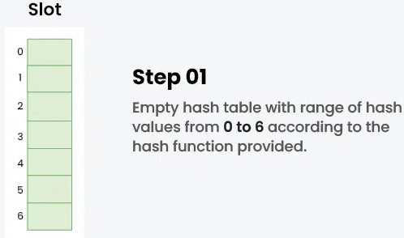
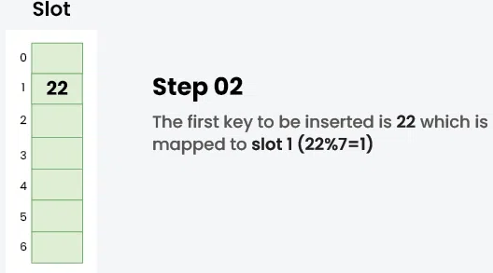
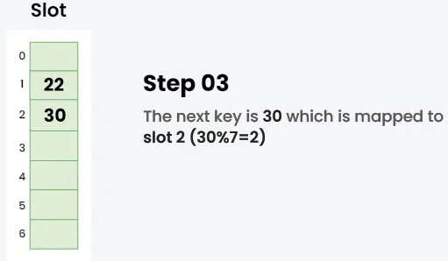
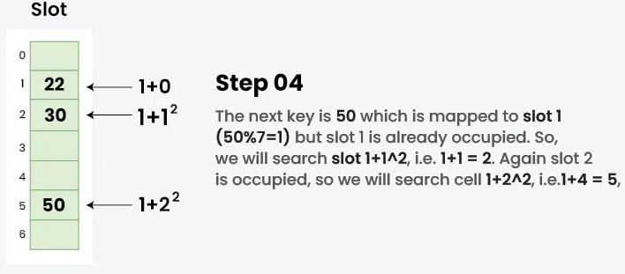
2. Hashing . . . Collision Resolution Techniques
Closed Hashing(Open Addressing): . . .
Quadratic Probing : . . .Example: hash function- key mod 5 , sequence of keys that are to be inserted are 50, 70, 76, 85, 93.
Notes:
as the hash table gets closer to being full, the performance of linear probing deteriorates because of a phenomenon called clustering. A cluster in linear probing is a sequence of contiguously occupied cells (with a possible wrapping). Clusters are bad news in hashing because they make the dictionary operations less efficient. As clusters become larger, the probability that a new element will be attached to a cluster increases; in addition, large clusters increase the probability that two clusters will coalesce after a new key’s insertion, causing even more clustering.

Slide 31
2. Hashing . . . Collision Resolution Techniques
Closed Hashing(Open Addressing): . . .
Double Hashing:
The intervals that lie between probes are computed by another hash function.
Double hashing is a technique that reduces clustering in an optimized way.
In this technique, the increments for the probing sequence are computed by using another hash function.
We use another hash function hash2(x) and look for the i*hash2(x) slot in the i^{th} rotation.
let hash(x) be the slot index computed using hash function:
If slot hash(x) % S is full, then we try (hash(x) + 1*hash2(x)) % S
If (hash(x) + 1*hash2(x)) % S is also full, then we try (hash(x) + 2*hash2(x)) % S
If (hash(x) + 2*hash2(x)) % S is also full, then we try (hash(x) + 3*hash2(x)) % S
Notes:
as the hash table gets closer to being full, the performance of linear probing deteriorates because of a phenomenon called clustering. A cluster in linear probing is a sequence of contiguously occupied cells (with a possible wrapping). Clusters are bad news in hashing because they make the dictionary operations less efficient. As clusters become larger, the probability that a new element will be attached to a cluster increases; in addition, large clusters increase the probability that two clusters will coalesce after a new key’s insertion, causing even more clustering.

Slide 32
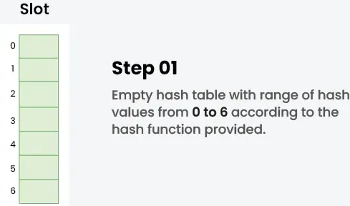
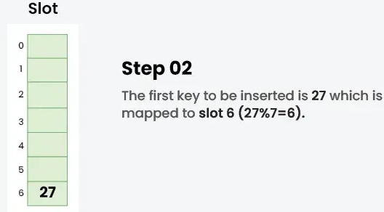
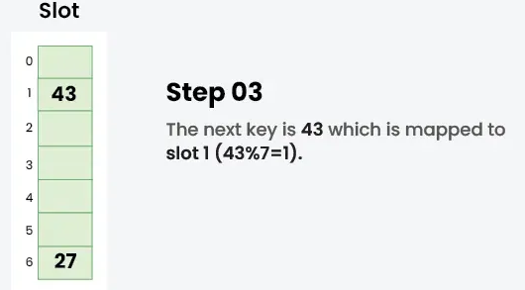
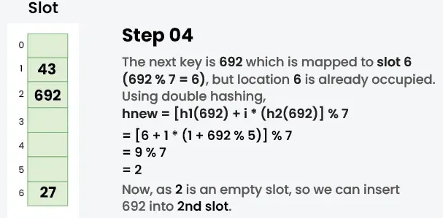
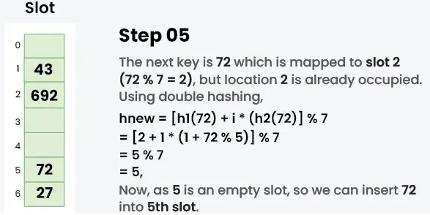
2. Hashing . . . Collision Resolution Techniques
Closed Hashing(Open Addressing): . . .
Double Hashing: . . .Example: 27, 43, 692, 72 into the Hash Table of size 7. where first hash-function is h1​(k) = k mod 7 and second hash-function is h2(k) = 1 + (k mod 5)
Notes:
as the hash table gets closer to being full, the performance of linear probing deteriorates because of a phenomenon called clustering. A cluster in linear probing is a sequence of contiguously occupied cells (with a possible wrapping). Clusters are bad news in hashing because they make the dictionary operations less efficient. As clusters become larger, the probability that a new element will be attached to a cluster increases; in addition, large clusters increase the probability that two clusters will coalesce after a new key’s insertion, causing even more clustering.

Slide 33
References
Anany Levitin: Introduction to the Design and Analysis of Algorithms, Third Edition, Pearson Education, 2012.
https://www.geeksforgeeks.org/dsa/hashing-data-structure/

Slide 34

! Thank You !

